Slide 1

Netflix stream search

Slide 2
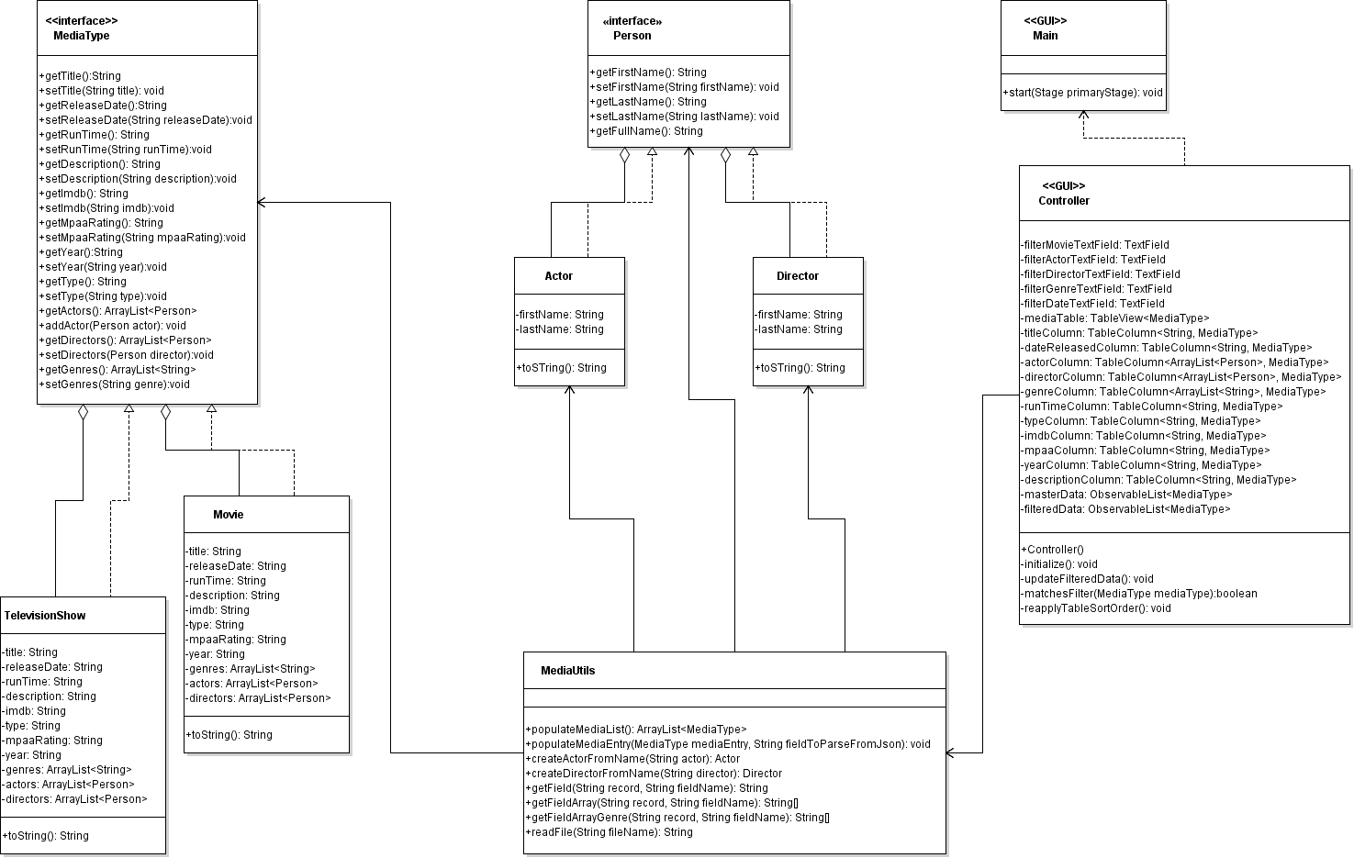

Slide 3

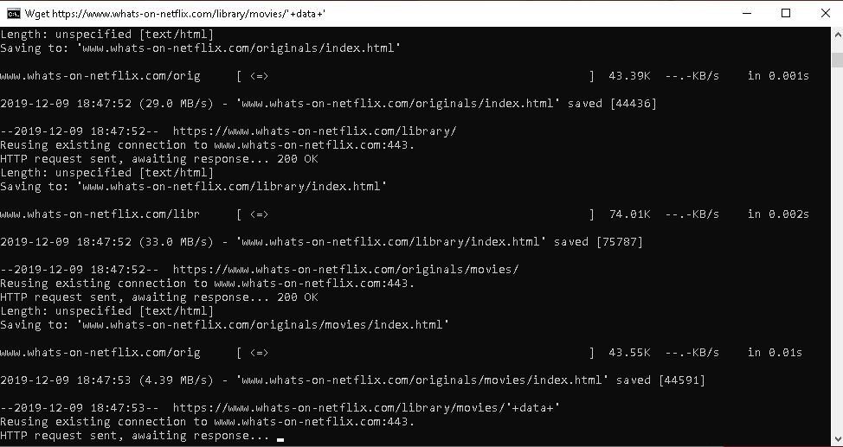
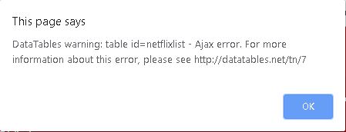

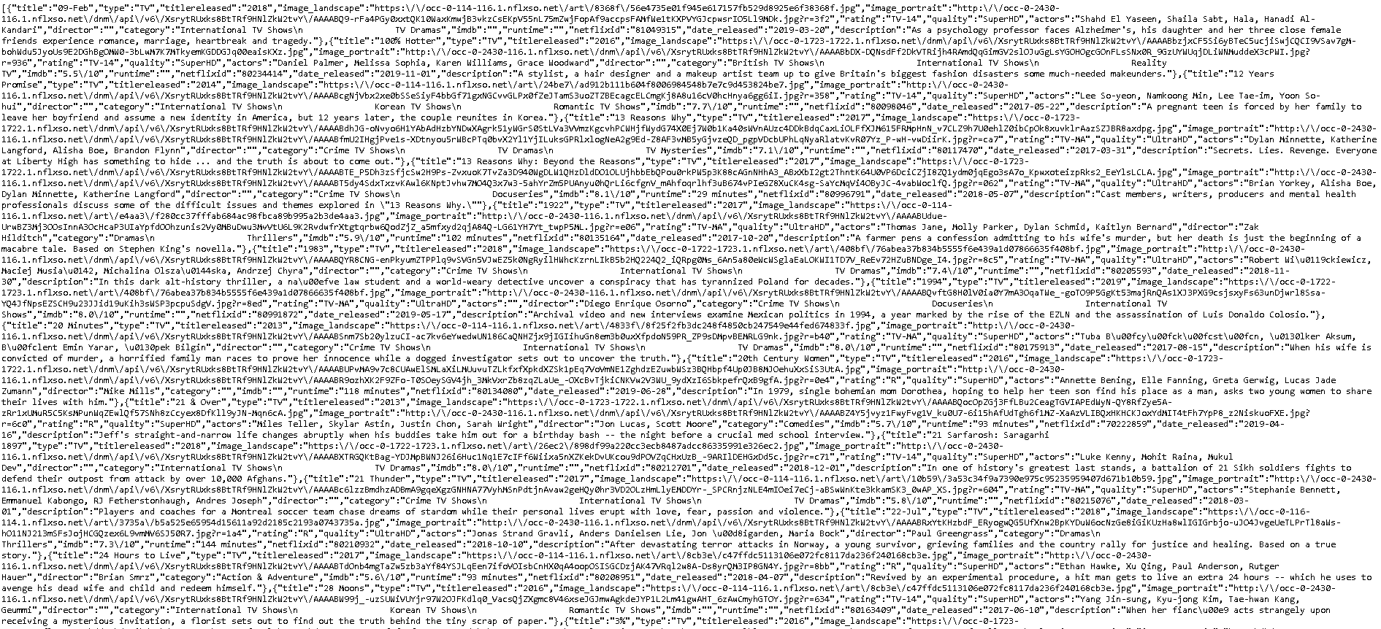


Slide 5
From data scrape > JSON Parsing > javafx gui
Movie Site
String Processing
GUI

